Slide 1
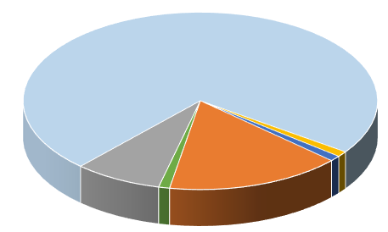
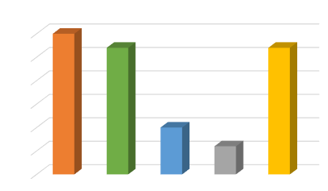
Poster Title Researchers/Presenters’ Names Institution/Organization/Company
Insert your institution’s logo here
LAY SUMMARY
OBJECTIVES
RESULTS
Consider adding a lay summary to your poster. Copy and paste your text content here, adjusting the font size to fit.
Copy and paste your text content here, adjusting the font size to fit.
Copy and paste your text content here, adjusting the font size to fit.
BACKGROUND
METHODS
Copy and paste your text content here, adjusting the font size to fit.
Take care with fonts. We suggest “Arial” as a sans-serif font, or “Times Roman” (not “Time New Roman”) for a serif font.Use the “Symbol” font for Greek characters.
Tips for Excel Charts
Copy and paste your Excel chart. The chart can be stretched to fit as required. If you need to edits parts of the chart, we recommend you edit the original chart in Excel, then re-paste the new chart.
Tips for Title/Headers Bar Color
How to change the poster title and headers background color:
Right click on the bar and select “Format Shape”. When the pop-up window comes up, select your color under “Fill” and then “Color” menu. For more effects select Fill Effects under the Color option.
CONCLUSIONS
Copy and paste your text content here, adjusting the font size to fit.
Copy and paste your text content here, adjusting the font size to fit.
Note to poster presenters: Insert additional logos/acknowledgments of Registry cohort funders (e.g., Cure JM, CDC, LADA, etc.) related to your project. Contact research@carragroup.org with any questions about appropriate acknowledgements.
REFERENCES
1. Journal Article, Name of Journal
2. Journal Article, Name of Journal
This work could not have been accomplished without the aid of the following organizations: The NIH’s National Institute of Arthritis and Musculoskeletal and Skin Diseases (NIAMS) & the Arthritis Foundation. We would also like to thank all participants and hospital sites that recruited patients for the CARRA Registry. The authors thank the following CARRA Registry site principal investigators: C. Aguiar Lapsia,G. Amarilyo,S. Ardoin,M. Basiaga,K. Baszis,L. Bermudez-Santiago,H. Brunner,H. Bukulmez,E. Chalom,Johanna Chang,Joyce Chang,D. Co,K. Cook,A. Cooper,C. Correll,T. Davis,M. DeGuzman,A. Dhanrajani,K. Ede,B. Edelheit,B. Feldman,D. Glaser,B. Gottlieb,T. Graham,T. Griffin,T. Hahn,O. Harry,M. Hollander,S. Hong,J. Hsu,A. Huber,L. Imundo,C. Inman,S. Kim,D. Kingsbury,M. Klein-Gitelman,L. Lim,M. Mannion,K. Marzan,D. McCurdy,D. Milojevic,S. Mohan,T. Moore,K. Moore,L. Moorthy,S. Nativ,M. Natter,K. Onel,J. Patel,S. Prahalad,A. Robinson,T. Ronis,M. Rosenkranz,N. Ruth,S. Sabbagh,K. Schikler,C. Schutt,E. Sloan,Y. Sterba Rakovchik,G. Syverson,S. Tarvin,M. Tesher,D. Toib,M. Toth,M. Twilt,H. Van Mater,D. Wahezi,P. Weiss,J. Weiss,L. Woolnough,E. Wu,A. Yalcindag

