Slide 1
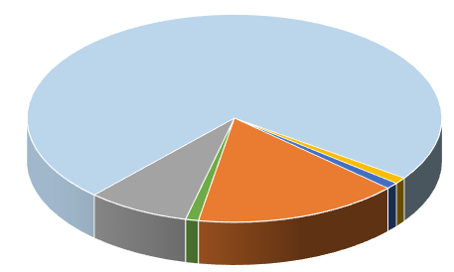
Poster Title Researchers/Presenters’ Names Institution/Organization/Company
Insert your institution’s logo here
LAY SUMMARY
OBJECTIVES
RESULTS
Consider adding a lay summary to your poster. Copy and paste your text content here, adjusting the font size to fit.
Copy and paste your text content here, adjusting the font size to fit.
Copy and paste your text content here, adjusting the font size to fit.
BACKGROUND
METHODS
Copy and paste your text content here, adjusting the font size to fit.
Take care with fonts. We suggest “Arial” as a sans-serif font, or “Times Roman” (not “Time New Roman”) for a serif font.Use the “Symbol” font for Greek characters.
Tips for Excel Charts
Copy and paste your Excel chart. The chart can be stretched to fit as required. If you need to edits parts of the chart, we recommend you edit the original chart in Excel, then re-paste the new chart.
Tips for Title/Headers Bar Color
How to change the poster title and headers background color:
Right click on the bar and select “Format Shape”. When the pop-up window comes up, select your color under “Fill” and then “Color” menu. For more effects select Fill Effects under the Color option.
CONCLUSIONS
Copy and paste your text content here, adjusting the font size to fit.
Copy and paste your text content here, adjusting the font size to fit.
The authors wish to acknowledge the ongoing Arthritis Foundation financial support of CARRA
REFERENCES
1. Journal Article, Name of Journal
2. Journal Article, Name of Journal

